Slide 1
CS 4530 & CS 5500
Software Engineering
Lecture 11.3: Acceptance and Inclusivity Testing
Jonathan Bell, John Boyland, Mitch Wand
Khoury College of Computer Sciences © 2021, released under CC BY-SA

Slide 2
Learning Objectives for this Lesson
By the end of this lesson, you should be able to…
Explain ways in which developers of software often differ from the users of that software, introducing potential inclusivity bugs
Recognize persona-based cognitive walk-throughs as an approach to help put yourself in someone else’s shoes

Slide 3
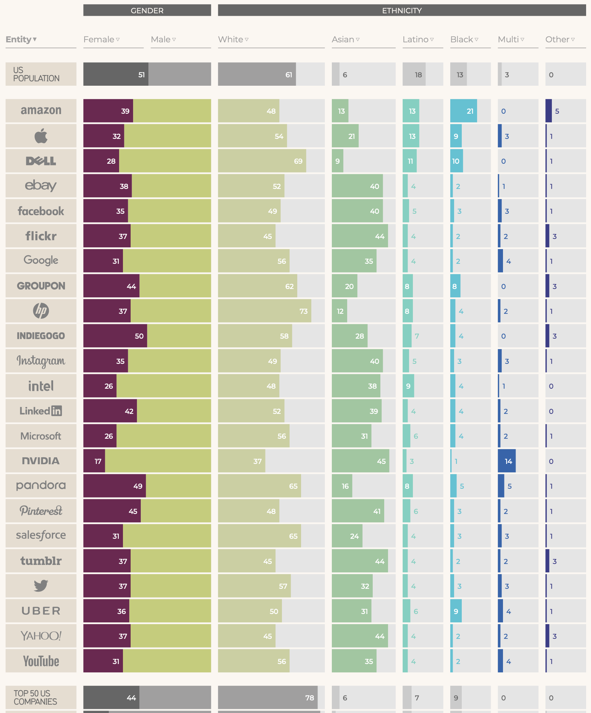
Bias is the Default
Data from 2017
We are not our users
Creating inclusive software requires us to acknowledge that we differ from our users
Our quality assurance is only as good as we can understand our users
https://informationisbeautiful.net/visualizations/diversity-in-tech/
Notes:
Our goal in this lesson is to explore approaches to detect equity and inclusivity bugs in software. How do we start? First, it is vital that we recognize that we each bring our own biases of how we expect our software to be used. Developers may differ from users in: nationality, ethnicity, race, gender, age, socioeconomic status, abilities, and belief systems. Creating inclusive software requires us to acknowledge these differences. Having diversity on your development team is one of the first steps towards creating inclusive software. However, attracting and retaining a diverse team is its own topic - this infographic shows the relative lack of diversity at top US-based tech firms, in comparison to the population of the US - teams often lack diversity in gender and ethnicity - and simplifying diversity to only gender and ethnicity can overlook other facets of how we vary. In this lesson, we’ll focus on approaches to better understand our users, and to evaluate whether our software is inclusive, usable, and accessible, or not.

Slide 4
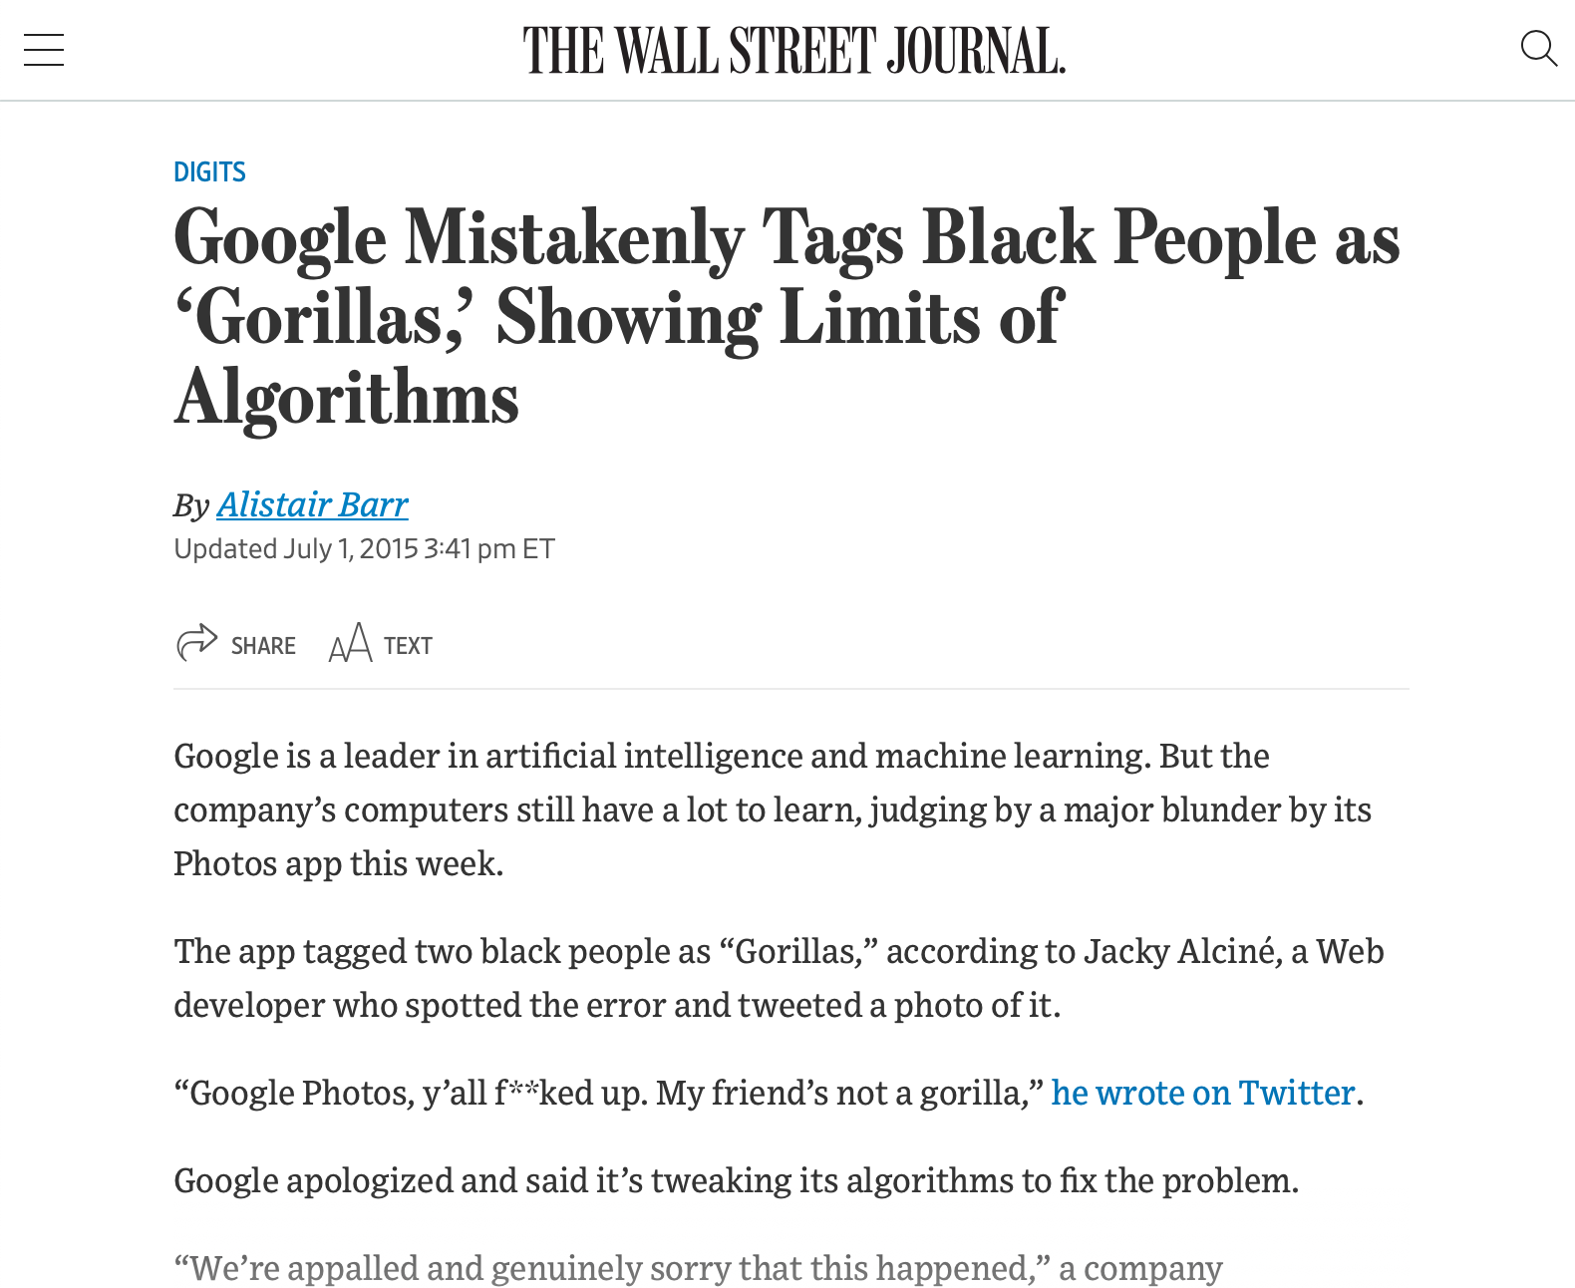
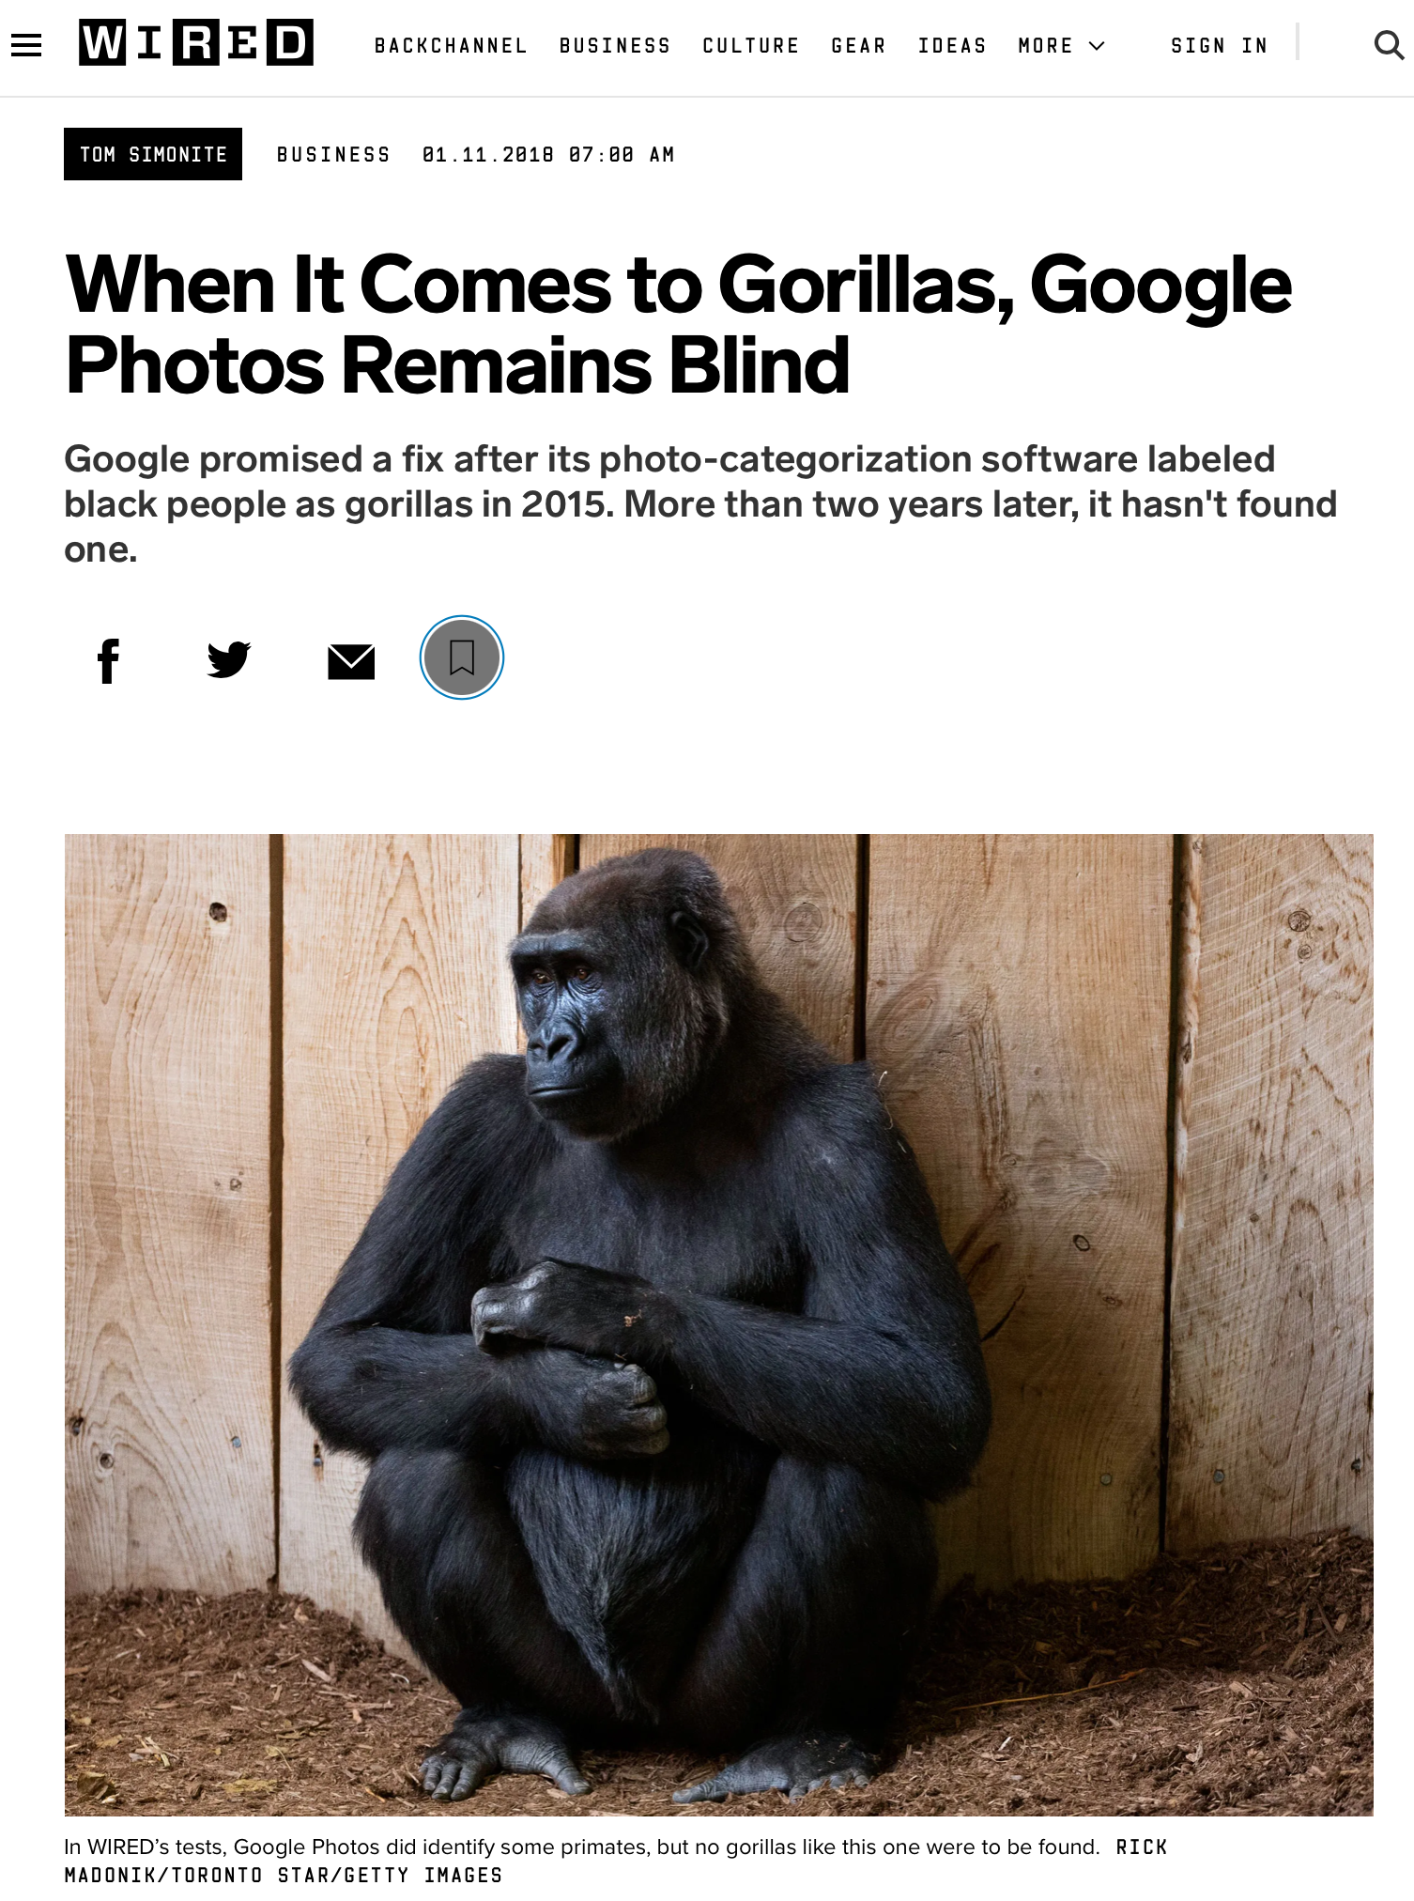
Bias is the Default
Example: Google Photos auto-tagging (2015)
https://www.wsj.com/articles/BL-DGB-42522
https://www.wired.com/story/when-it-comes-to-gorillas-google-photos-remains-blind/
Notes:
As a case example of bias as the default, consider this incident from 2015, when google released a new photo tagging feature in Google Photos, which was prone to misidentify black people in photographs as gorillas. How did this happen? Image recognition algorithm depend on being supplied a proper (complete) dataset - clearly an incomplete dataset, not representative of entire population. Why didn’t this come up in internal testing? To the extent that Google has a diverse development team today, that was much less true in 2015 - so nobody was trying it and finding this out, and the unconscious bias of the organization resulted in this product getting out. This was harmful both to users, and to Google’s reputation. Even today, this is not very well fixed - and is mostly side-stepped by not identifying any image as a gorilla. It’s useful to think of a case like this to set the tone for a conversation about diversity and inclusivity, but let’s focus now on more subtle errors.

Slide 5

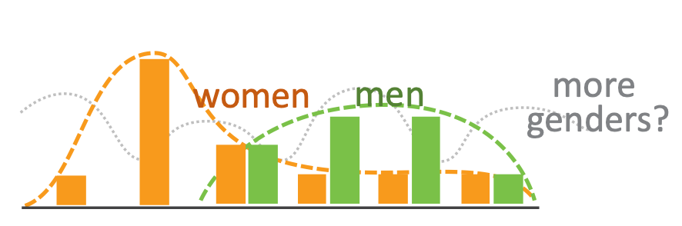

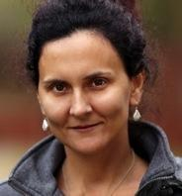

Unconscious Bias in Software
Does your software support a variety of users?
Aside from gender, race and ethnicity, how people interact with software varies, research has shown key inclusiveness facets:
Motivations
Information processing style
Computer self-efficacy
Risk averseness
Tech learning style
Idea: Perform cognitive walkthrough of our software, through the lens of someone else
Notes:
Aside from algorithmic biases, how does our unconscious bias translate into software that is not inclusive? Aside from gender, race and ethnicity, HOW people interact with software varies. Research has shown several key inclusiveness facets:
Motivations: do you learn new technologies in your free time, or only when you need to?
Information processing: do you gather all information comprehensively before trying to solve something, or do you selectively
Computer self-efficacy: Do you feel confident about your ability to interact with a computer? If you struggle, do you blame yourself or the vendor?
Risk: will I make a mistake/spend more time than I have budgeted on this? If you try something that doesn’t work, does that change your attitudes towards that technology?
Tech learning style: do you favor process-oriented learning (go step-by-step) or tinkering?

Slide 6
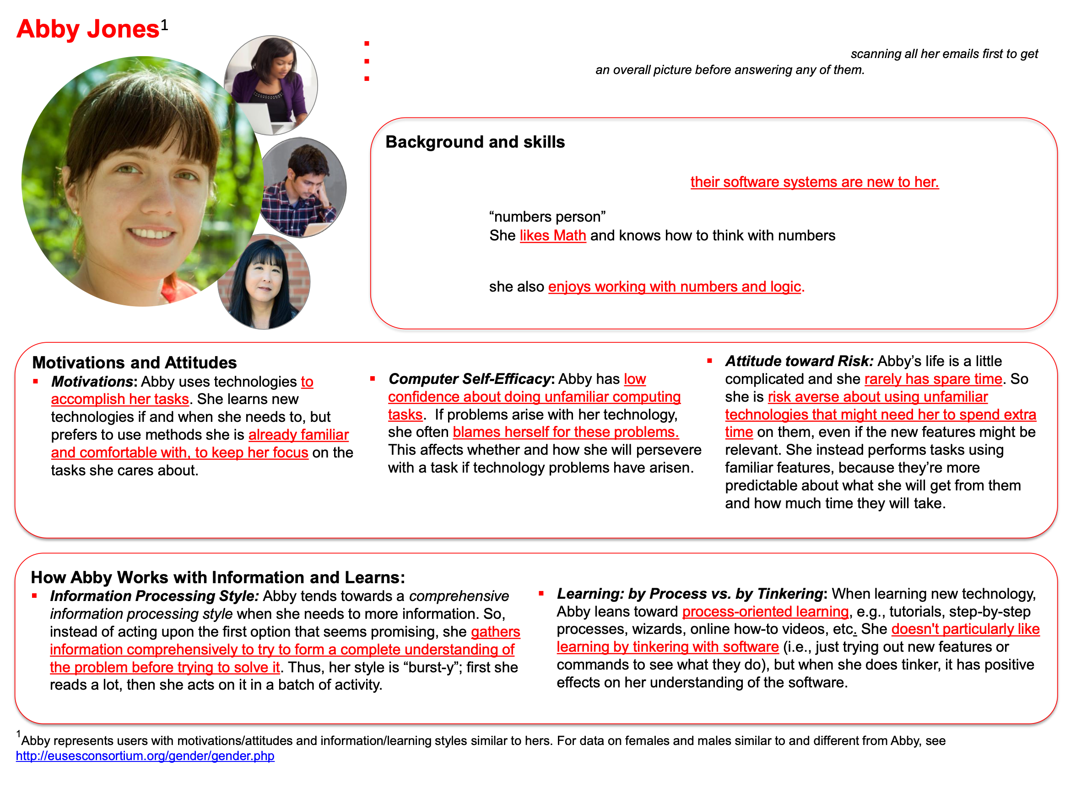
GenderMag: Gender Inclusiveness Magnifier
Persona-based evaluation
http://gendermag.org/foundations.php
Notes:
Persona-based evaluation allows for a “discount” usability evaluation. We don’t actually need to find real users who are different from us and get them to use our software (although that’s the best validation) - we can probably find lots of issues just by carefully walking through how someone like this persona would use our software (note: not actually persons that you know, not necessarily gendered)

Slide 7
GenderMag: Gender Inclusiveness Magnifier
Persona-based evaluation
Step through a use case for your tool, acting as the persona
Avoid jumping to conclusions - work in a group with multiple evaluators, take notes of issues as they occur
Compare to heuristic evaluation (week 6)
http://gendermag.org/Docs/GenderMagHandout-2020-0106-1649.pdf
Notes:
To perform a cognitive walkthrough, you and your team step through a single use case for your tool, acting as the persona. For example: consider applying the Abby persona to evaluate an augmented reality application for navigating a book store…
Step by-step, note that “see map?” Is a difficult subgoal to form: abby’s motivation is to find science fiction books - why would they know that finding map is the right thing? Then - note that “see bookstore map” is a “maybe” because Abby’s goal is “see map” but nothing says map! We developers know that ‘Browse off’ means to switch from a view where we are browsing a shelf to instead show the default, map view. If we’re not sure that Abby would know what to do [does abby tinker?], we note that, but then do it anyway. Then, if we end up getting a map, we evaluate: does abby see progress to that subgoal of finding map? Maybe, maybe not - confusing. The facets of Abby’s persona allow us to imagine how another user, who doesn’t think like us, might interact with the same interface in a different way.

Slide 8
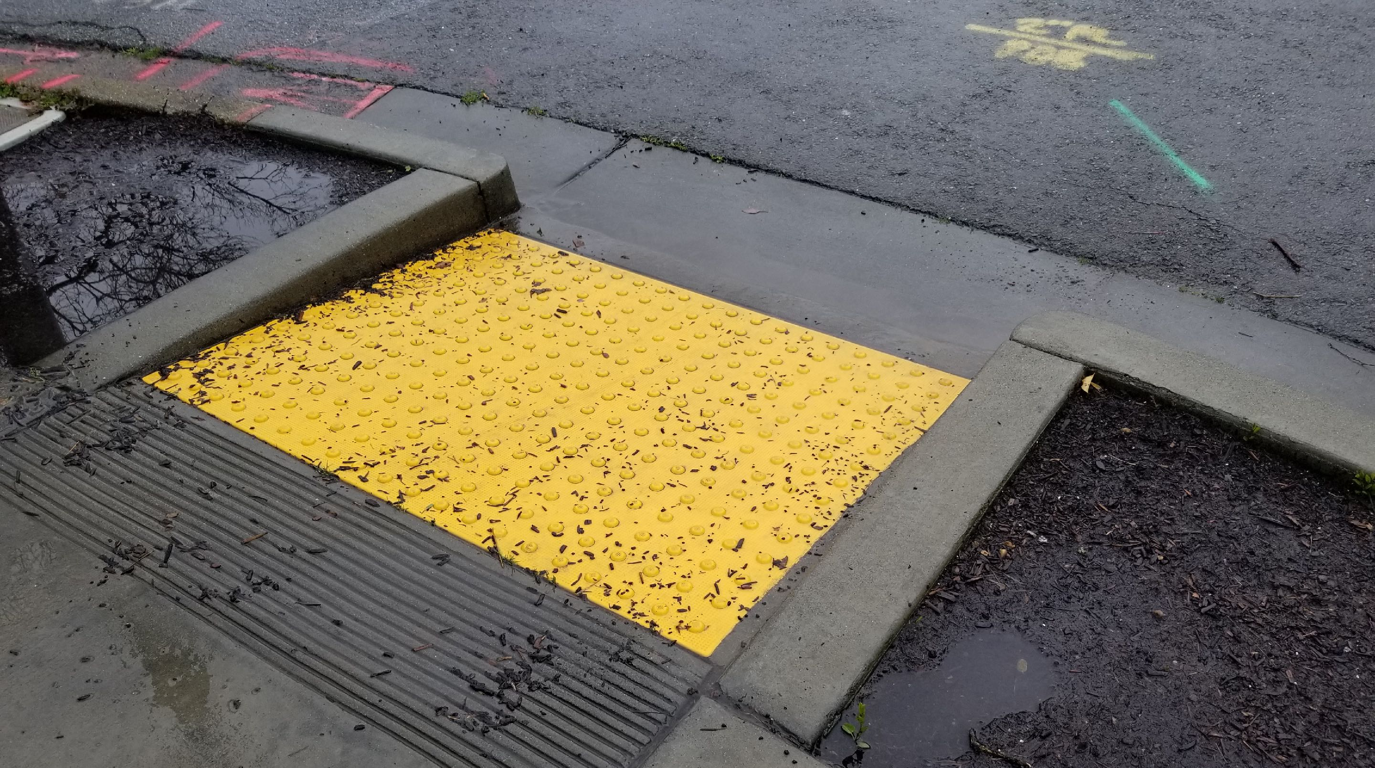
The Curb Cut Effect
“Curb Cuts” by Mike Gifford, CC BY-NC 2.0
Notes:
“The curb cut effect” describes broadly what happens when an inclusive design, built for one audience, benefits everyone. The effect gets its name from curb cuts - the small ramps between sidewalks and streets that were originally designed to allow people in wheelchairs to cross the street. However, this also benefits the old (who might struggle with a step), parents with strollers and workers making deliveries on hand trucks. For Example: Risk averse persona. Imagine that you are sloppy with vocabulary. “Browse off” vs “view map”. This is confusing. This is somethign that the risk averse individual might say “Wait what am I doing? I thought I was looking for a map. Oh I guess it’s turning off the browse feature?” This is like curb cuts though - it helps everyone, since, even if you weren’t particularly confused, it’s still a bit of a road bump.

Slide 9
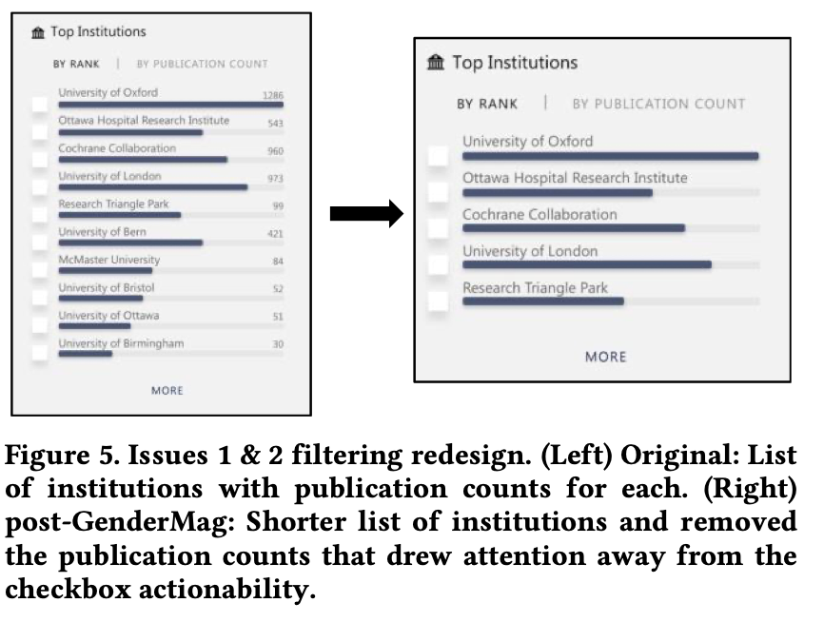
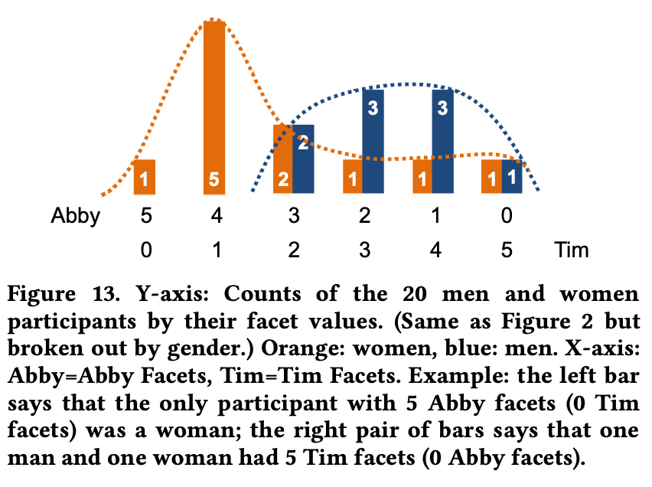
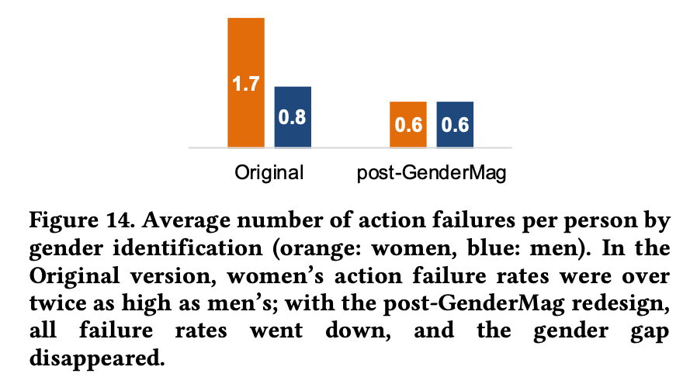
Usability Testing
Directly measuring the usability and inclusivity of our software
Observe real users interacting with your software - provide each user with a task, monitor their progress towards completing that task
Consider a diverse set of users that represent those who will use your software
Validate problems (and fixes) that you identify in cognitive walkthroughs
Example: applying GenderMag + usability testing for Microsoft Academic
ftp://ftp.cs.orst.edu/pub/burnett/chi19-GenderMag-findToFix.pdf
Notes:
The gold-standard for evaluating the efficacy of our software is usability testing.
Directly measure usability by monitoring task performance
Use diverse users, consider surveying based on facets - see figure in middle
Compare performance across interfaces (left figure, from MS academic prototype, can see it live)
Validate problems + fixes - and even find curb cut effect (Right figure)

Slide 10
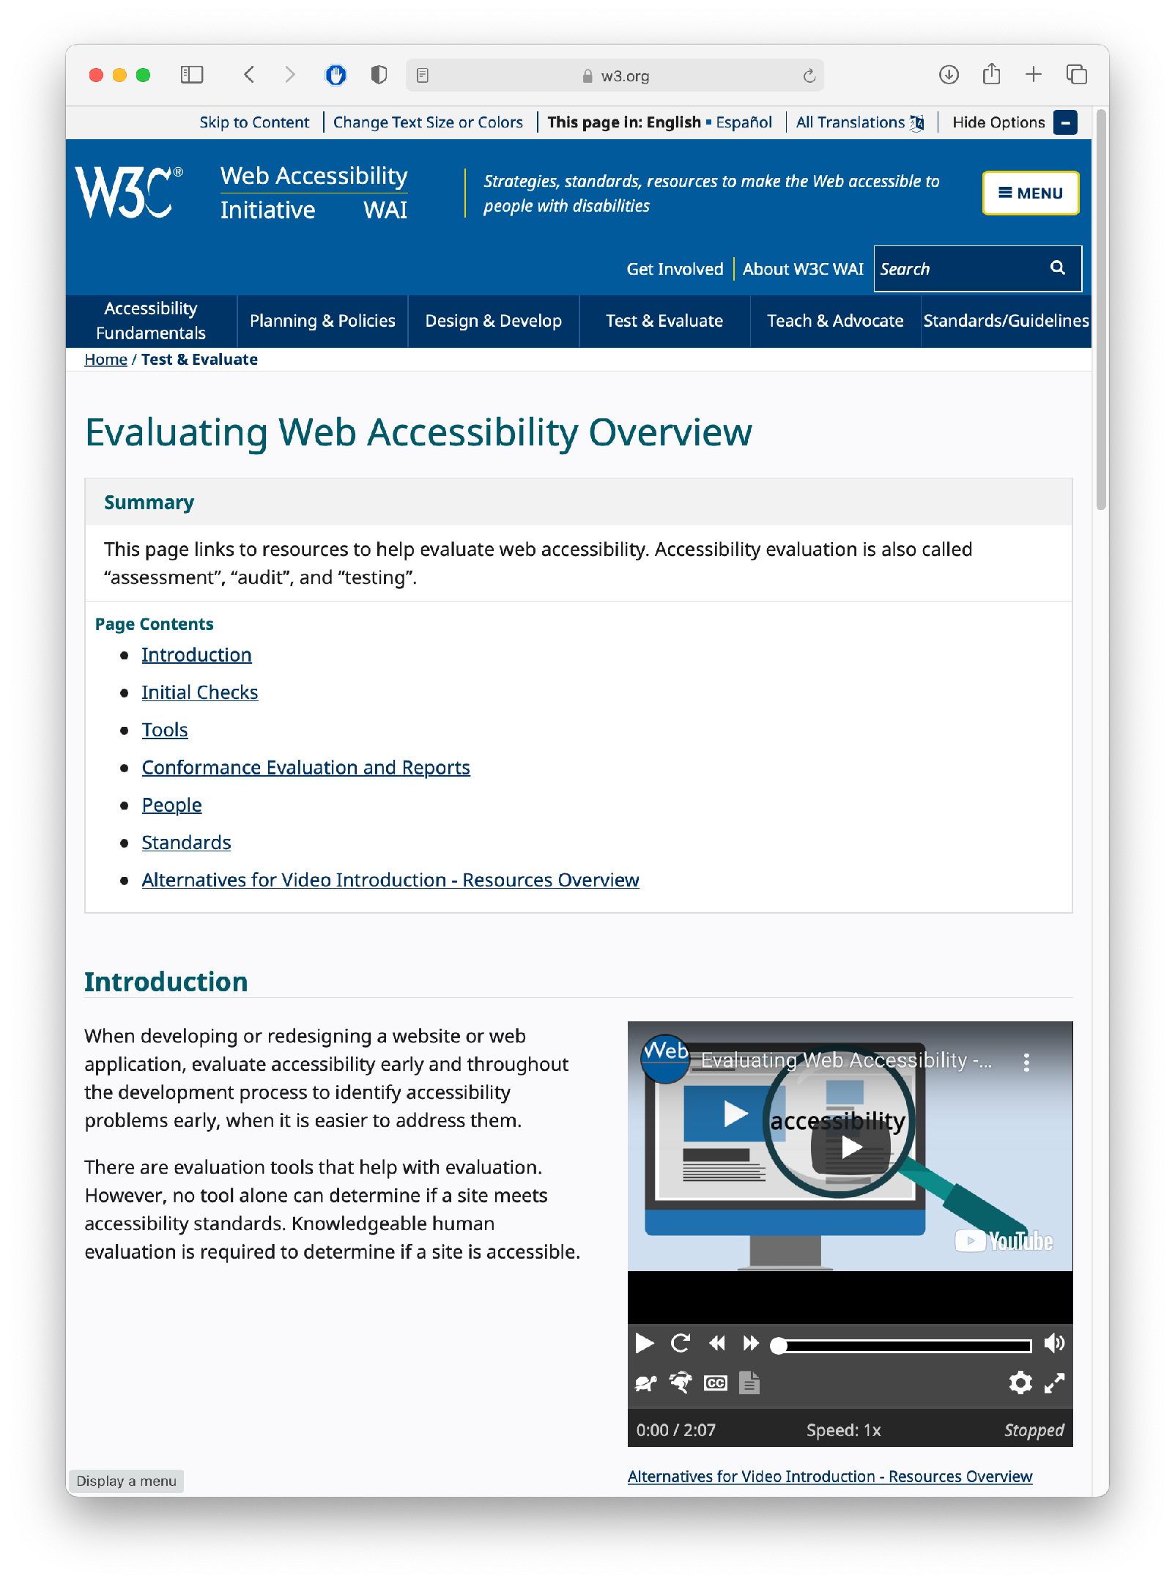
Usability Testing
Evaluating Accessibility
Check for conformance with requirements of standards
Involve users in your evaluation - simply “meeting a standard” does not guarantee accessibility
https://www.w3.org/WAI/test-evaluate/
Notes:
Evaluating accessibility is another form of usability testing. We can begin by checking (ourselves) the conformance of our application with the requirements laid out by standards, like the W3C’s WCAG standards. Simply meeting a standard doesn’t mean that it’s usable, and simply having one disabled person say that it works for them doesn’t mean that it’s usable - still conduct a broad user study for best results.

Slide 11
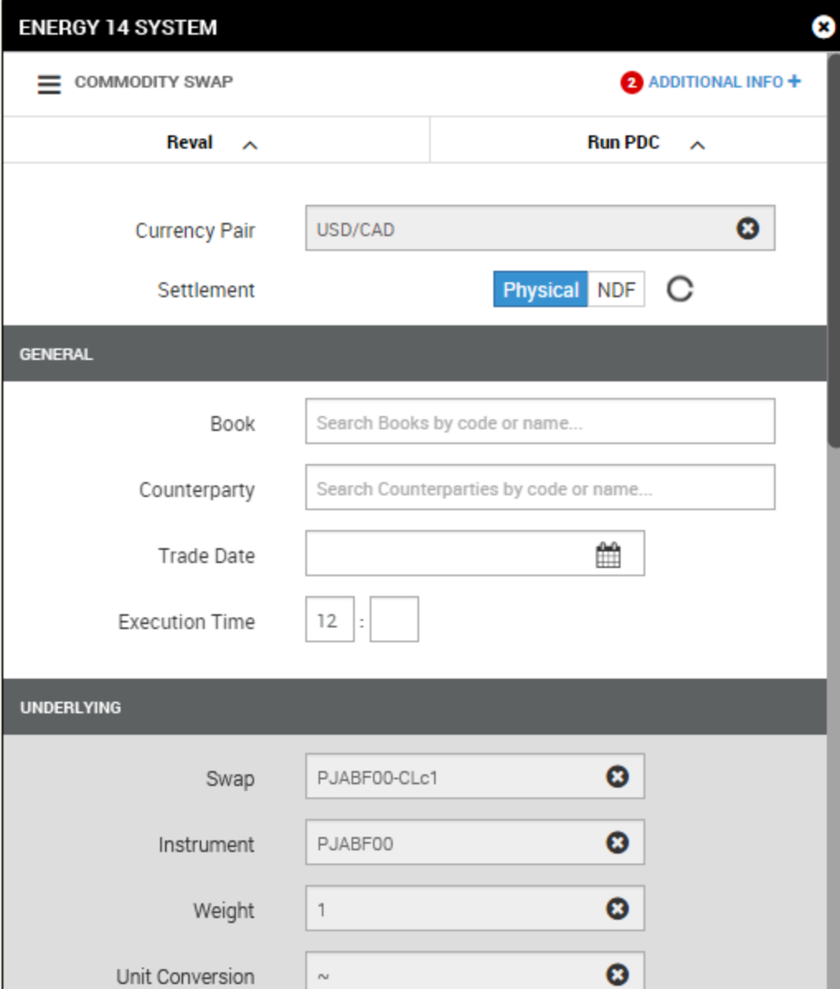
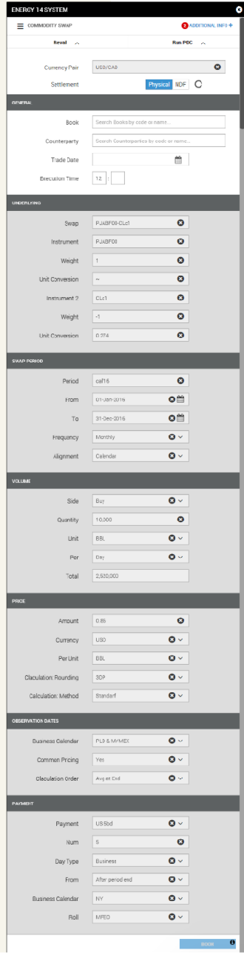
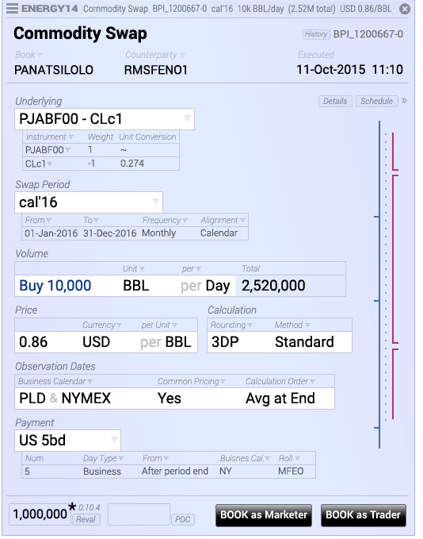
Usability Testing
For some software, we are nothing like our users
Commodity swap screens & story © 2016, Brad Paley
http://didi.co/consulting/
Notes:
User studies are extremely useful both when trying to build inclusive software that works for lots of users, and also extremely niche software that solves a specialized task. This is for energy commodities swap, a task that commodities traders might do many times an hour. Left interface seems “right” following Nielsen heuristics. But, the form needs to be filled out extremely fast - and it doesn’t even fit on a page! Right interface is the re-design, compresses data, meets users mental models. Better that you do this kind of testing before declaring your software “complete” so that you don’t get fired and lose a contract…

Slide 12
Usability Testing in Continuous Development
A/B Testing
Ways to test new features for usability, popularity, performance without a focus group
Show 50% of your site visitors version A, 50% version B, collect metrics on each, decide which is better
Notes:
In a continuous development environment, we can do live user studies with A/B testing…

Slide 13
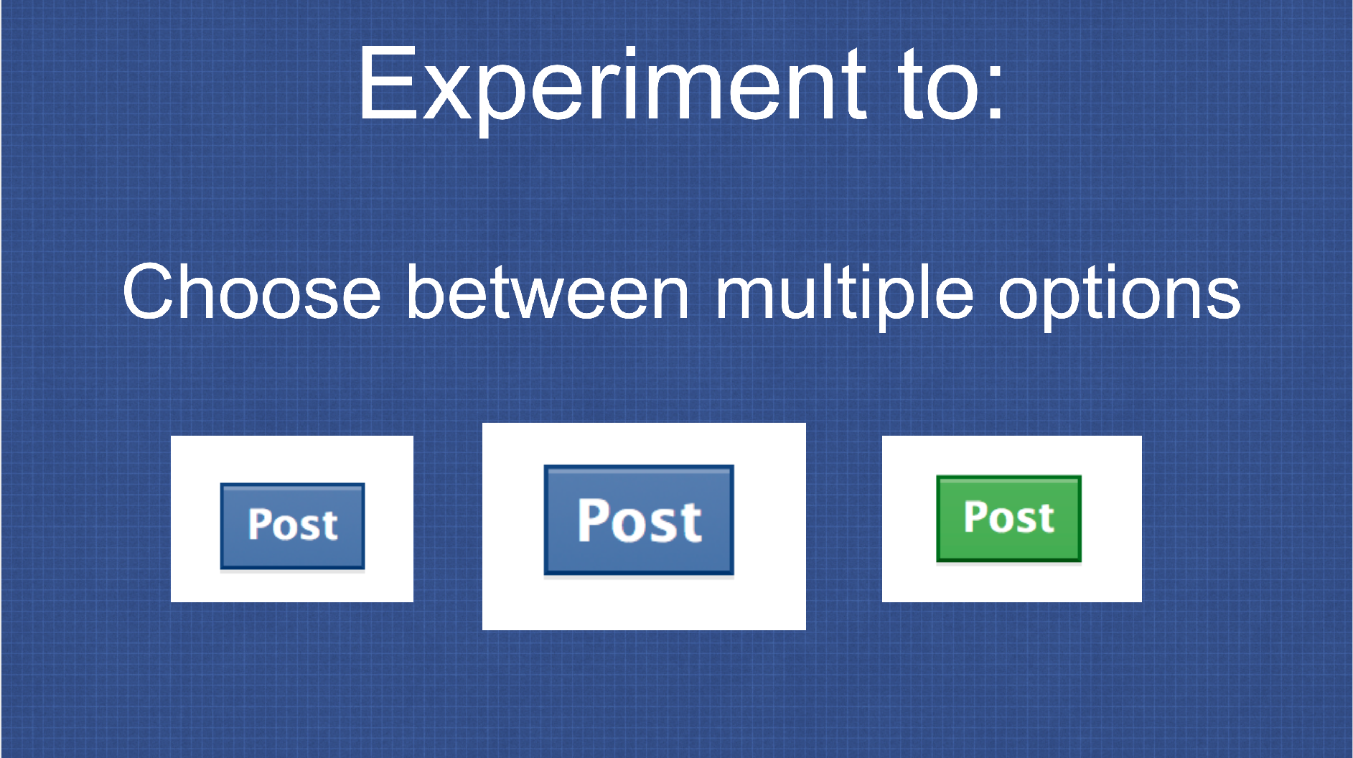
Usability Testing in Continuous Development
A/B Testing: PlanOut from Facebook (“N=10⁹ user study”)
Used to test advertising strategies (and Facebook functionality)
Segment audience and define KPIs, collect results
https://github.com/facebook/planout
https://www.slideshare.net/optimizely/opti-con-2014-automated-experimentation-at-scale
Notes:
Facebook performs these experiments constantly, and has even constructed an open source tool for doing so.
Basically doing a psychology experiment - try to avoid being evil (“show users sad posts, does that make them sad?”). Key feature: segment audience (think about diverse users) and collect results

Slide 14
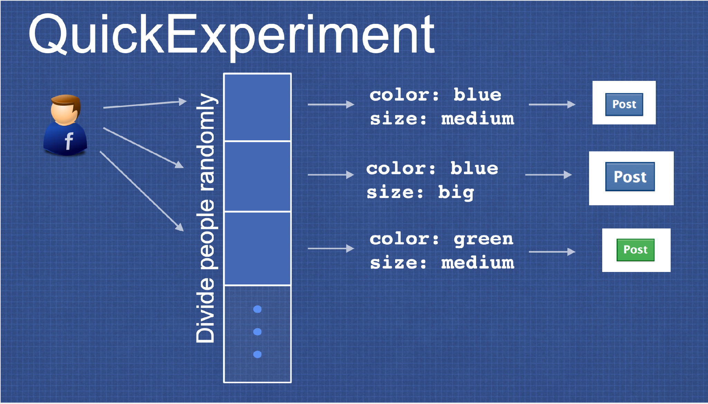
Usability Testing in Continuous Development
A/B Testing: PlanOut from Facebook (“N=10⁹ user study”)
https://github.com/facebook/planout
https://www.slideshare.net/optimizely/opti-con-2014-automated-experimentation-at-scale
Notes:
Example for a quick experiment - divide people randomly, show different post buttons

Slide 15
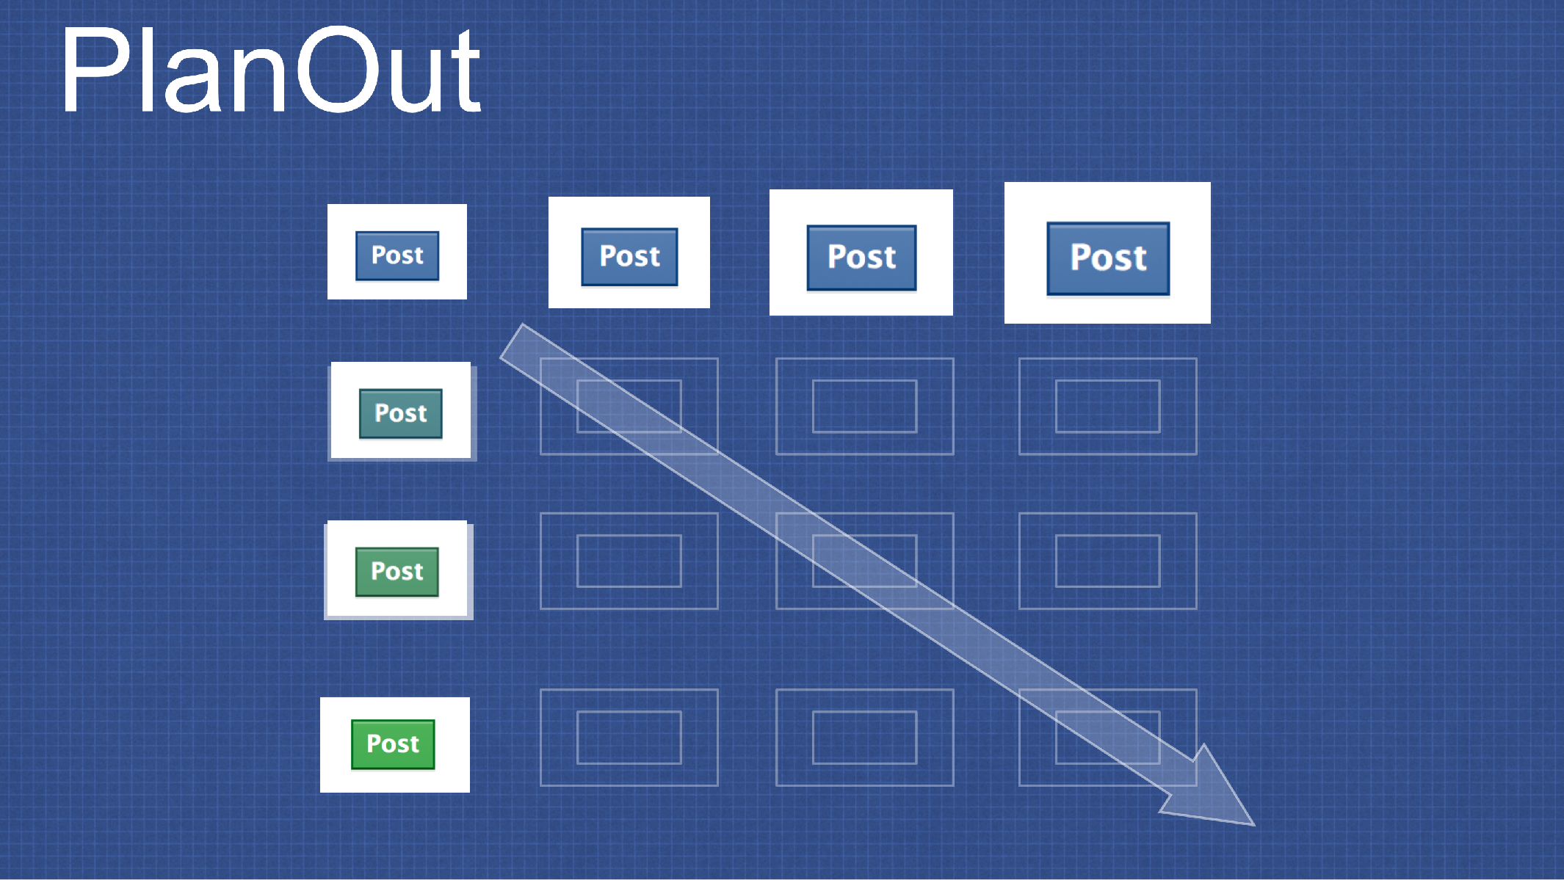
Usability Testing in Continuous Development
A/B Testing: PlanOut from Facebook (“N=10⁹ user study”)
https://github.com/facebook/planout
https://www.slideshare.net/optimizely/opti-con-2014-automated-experimentation-at-scale
Notes:
Can also consider gradients of options - say, controlling for size, and color

Slide 16
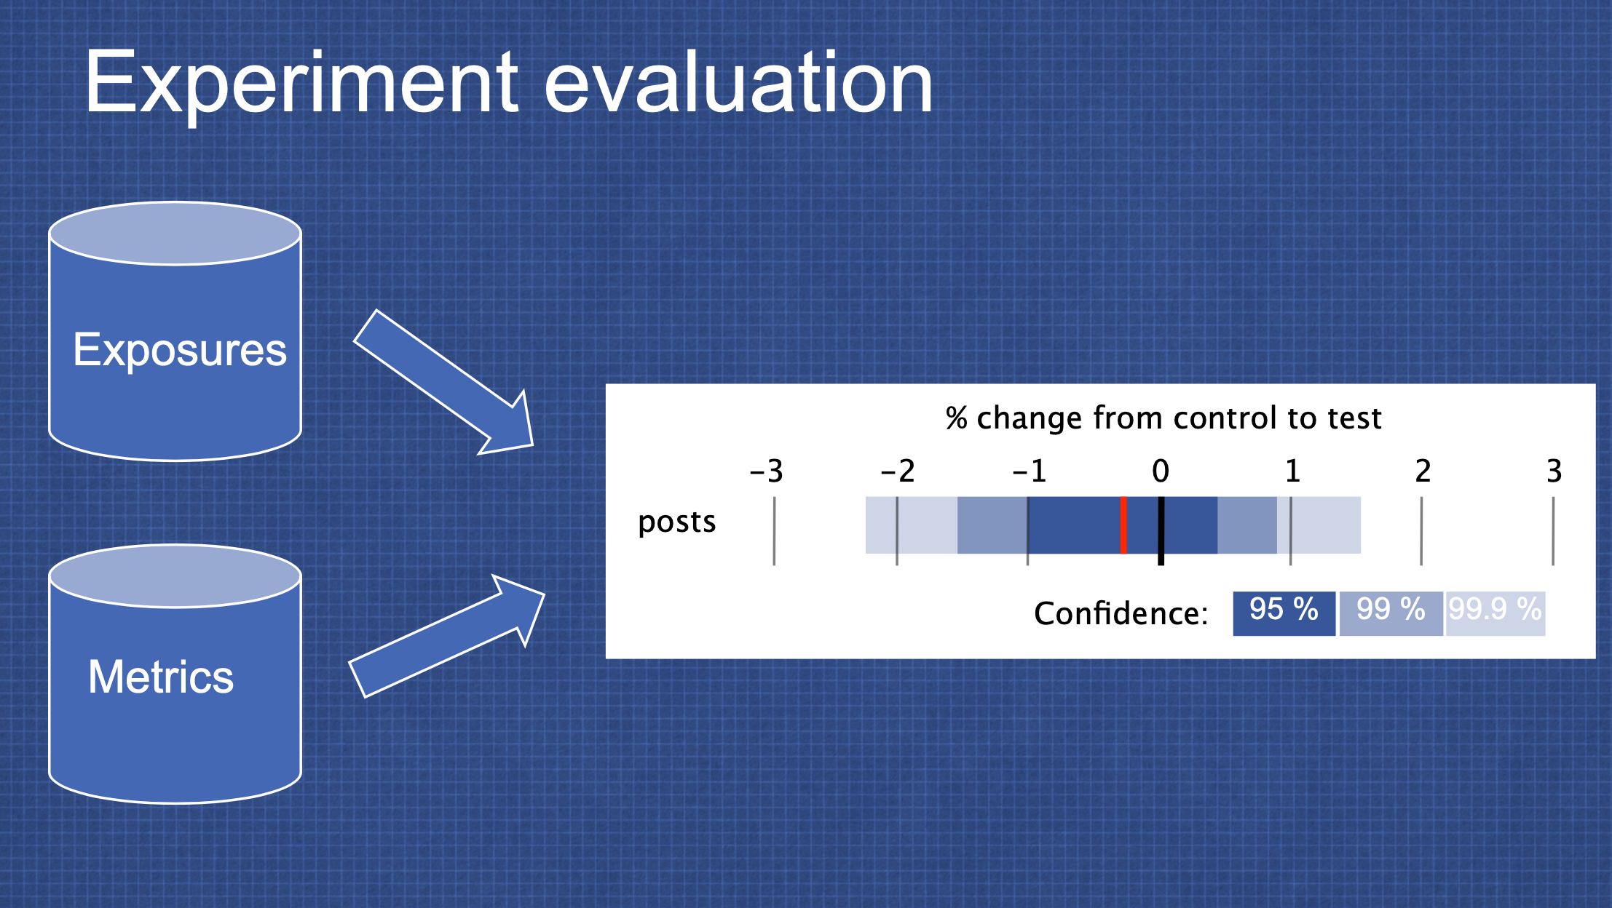
Usability Testing in Continuous Development
A/B Testing: PlanOut from Facebook (“N=10⁹ user study”)
https://github.com/facebook/planout
https://www.slideshare.net/optimizely/opti-con-2014-automated-experimentation-at-scale
Notes:
Then, take exposures + metrics, evaluate your KPI

Slide 17
Engineering Equitable Software
Key takeaways
With great power comes great responsibility
Anticipate the unanticipated consequences of your software
Limiting the accessibility of software might save money in the short term, but cost much more in the long term
Form a diverse development team, and involve a diverse group of users to validate your software
Notes:
There is an imbalance of power between those who write software and those who are subject to the implications of that software, sometimes at a disadvantage. As software engineers, it is vital that we anticipate the unanticipated - how might our software be inadvertently causing harm. Even if we are not building radiation therapy machines that can literally kill our users, we are still in a position of power to create software that is inclusive, and equally accessible to users who are not like us. Limiting the accessibility of our software (for instance, not adding support for screen readers, or not fixing the kinds of inclusivity bugs found by gendermag) might save money in the short term, but will likely end up costing much more in the long term. That you are taking this class, and still listening to this lecture likely means that you aspire to become an exceptional engineer - solve problems, and drive positive outcomes for a broad base of people. To do so, hopefully you are now aware of some strategies to consider how the software you build will be impact humanity, hopefully, for the better.

Slide 18
This work is licensed under a Creative Commons Attribution-ShareAlike license
This work is licensed under the Creative Commons Attribution-ShareAlike 4.0 International License. To view a copy of this license, visit http://creativecommons.org/licenses/by-sa/4.0/
You are free to:
Share — copy and redistribute the material in any medium or format
Adapt — remix, transform, and build upon the material
for any purpose, even commercially.
Under the following terms:
Attribution — You must give appropriate credit, provide a link to the license, and indicate if changes were made. You may do so in any reasonable manner, but not in any way that suggests the licensor endorses you or your use.
ShareAlike — If you remix, transform, or build upon the material, you must distribute your contributions under the same license as the original.
No additional restrictions — You may not apply legal terms or technological measures that legally restrict others from doing anything the license permits.

